Slide 1

L.L.A.M.A. Inc. (Libraries, Life, And Medical Assistance)
Empowering communities with knowledge and care

Slide 2



Slide 3
Motto: “These are the Bits You're Looking For!”

Slide 4
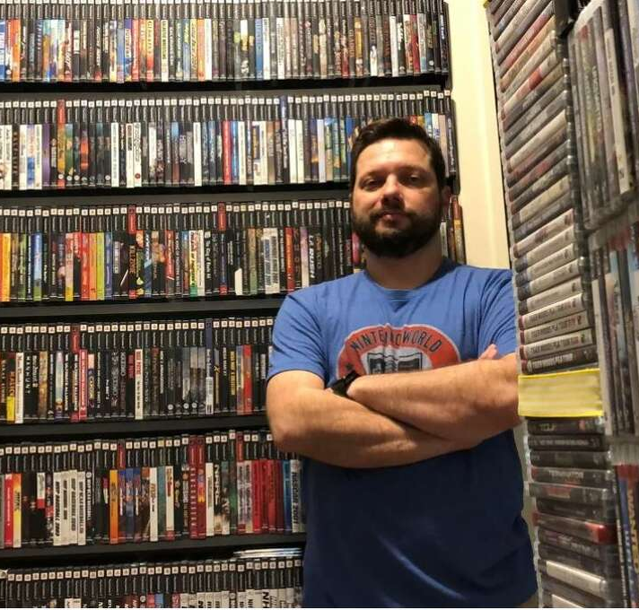
Meet Sam:
Sam has an extensive collection of video games and consoles, and he wants to create a list of his items to determine their potential worth

Slide 5
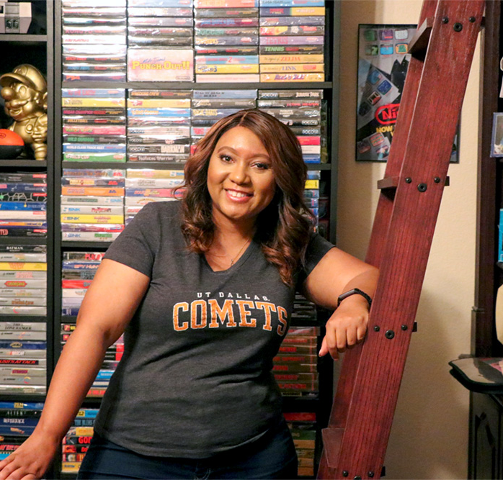
Meet Gwen:
Gwen wants to share the joy of her video game collection by selling them online.

Slide 6
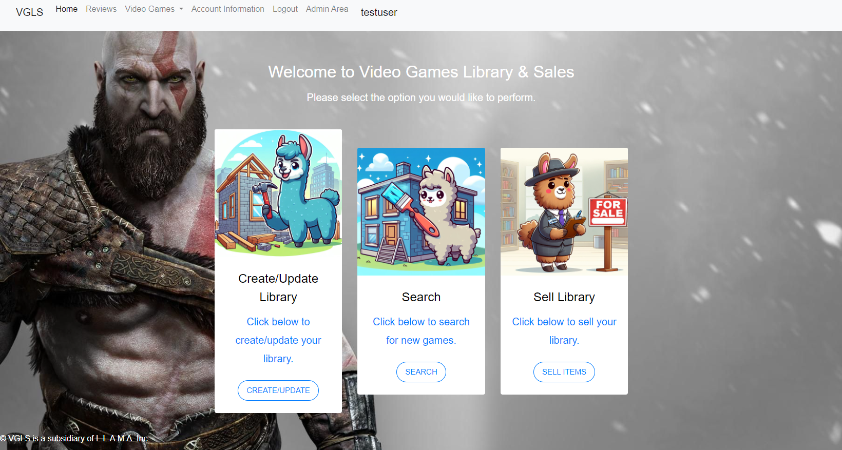
Demo

Slide 7

Video Game Library & Sales
Future Plans
Allow the users to buy and sell items through the website.
Utilize an LLM to create video game recommendations to users.

